Slide 1
EMPLOYEE LEAVE FLOWCHART

Slide 2

KEY SYMBOLS USED IN FLOWCHART
START/END
DATABASE
PROCESS
DECISION
OFF-PAGE REFERENCE
(OUTGOING)
DATA
OFF-PAGE REFERENCE(INCOMING)
PRINTOUT
FLOWLINE

Slide 3
START
USERNAME PASSWORD
LOGIN
N
FORGOT
PASSWORD
?
N
VALID
?
Y
Y
EMAIL
RESET
PASSWORD
A
SUCCESSFUL
?
N
Y

Slide 4
MANAGE
LEAVE
?
N
B
A
Y
CANCEL
LEAVE
?
APPLY
LEAVE
?
N
N
N
N
SOFT
DELETE
LEAVE
?
N
AMEND
LEAVE
?
Y
Y
Y
Y
DATES,DAYS,STATUS,DEPARTMENT
REASONS FOR AMENDMENT
REASONS FOR CANCELLATION
SOFT
DELETE
LEAVE
VIEW
LEAVE
AMEND
CANCEL LEAVE
MANAGE
FEEDBACK
SUBMIT
C

Slide 5
CHANGE PASSWORD
?
N
B
Y
OLD PASSWORD
NEW PASSWORD
REPEAT PASSWORD
CHANGE
PASSWORD
N
SUCCESSFUL
?
Y
LOG OUT
C

Slide 6
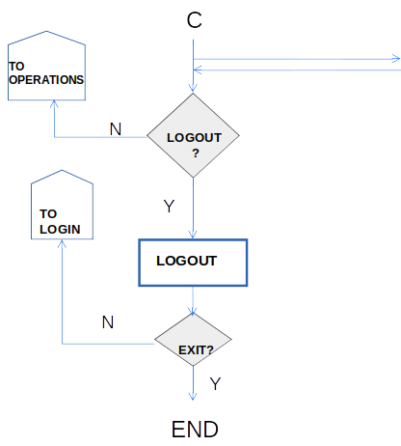
C
DATABASE
END

